Slide 1

Who is he?

Slide 2

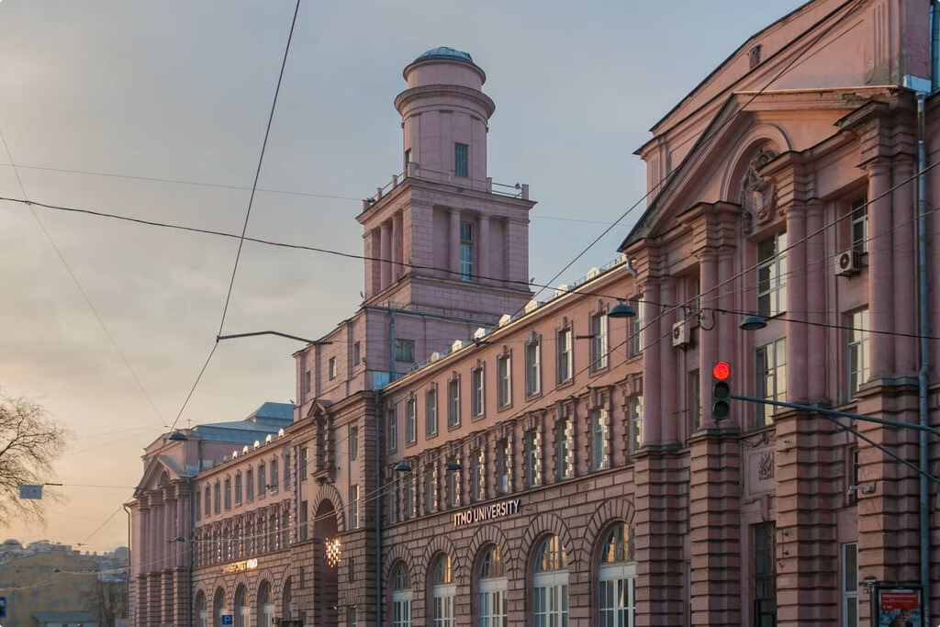
It's corny
1
He studies at ITMO University
2
He’s in our group

Slide 3
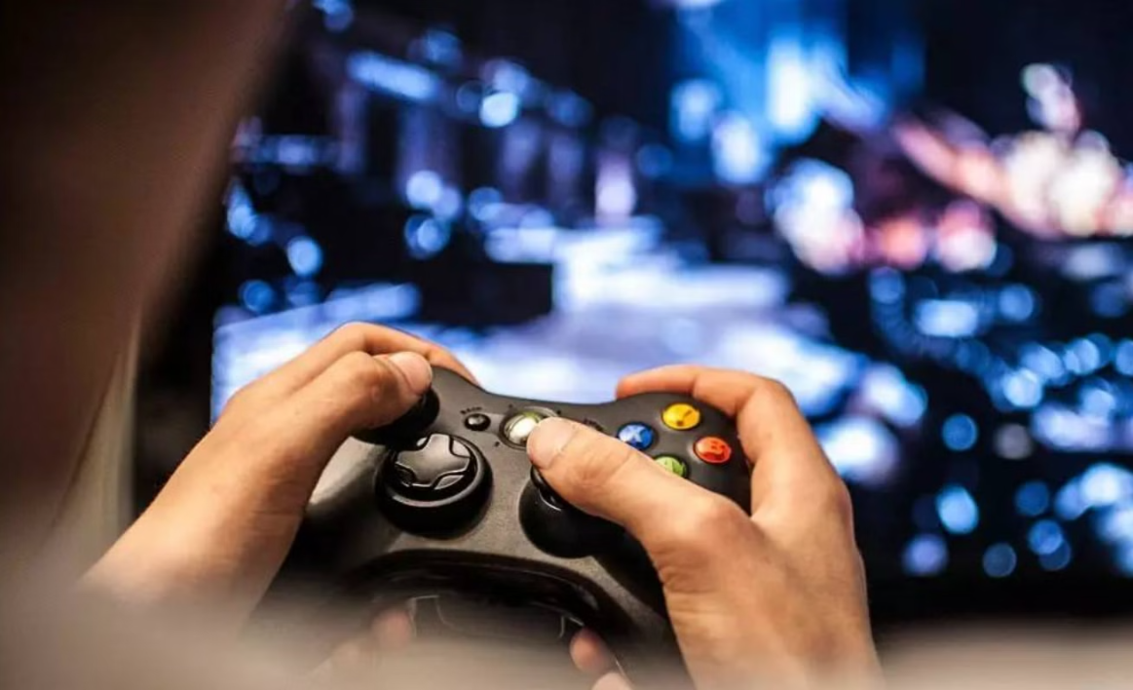
His hobby is making games
He is from Sevastopol

Slide 4



His hair is brown
His eyes are
“somewhat green”

Slide 5
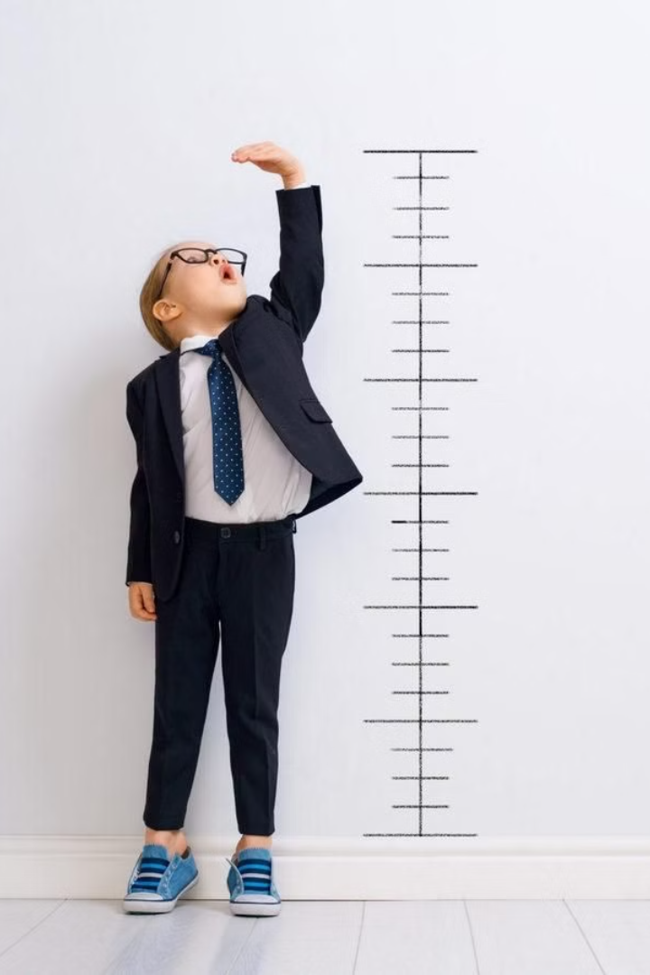
Physical characteristics
He was born on August 10, 2006
Не is 190+ cm high

Slide 6
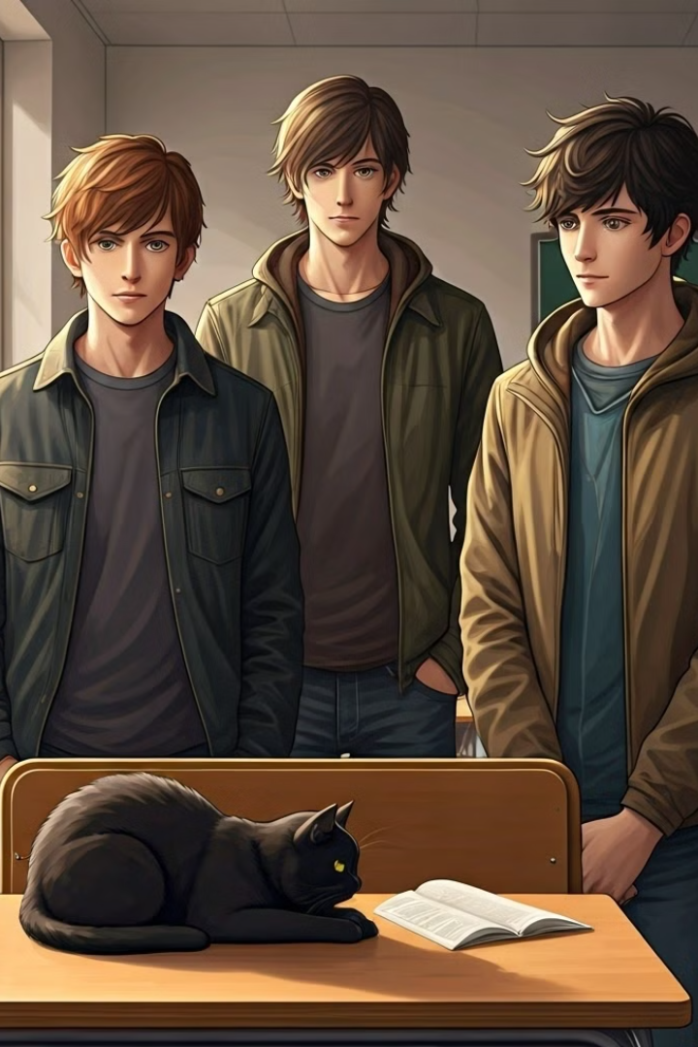
Interesting facts
There are 3 students in the class with the same name
He has a black cat

Slide 7
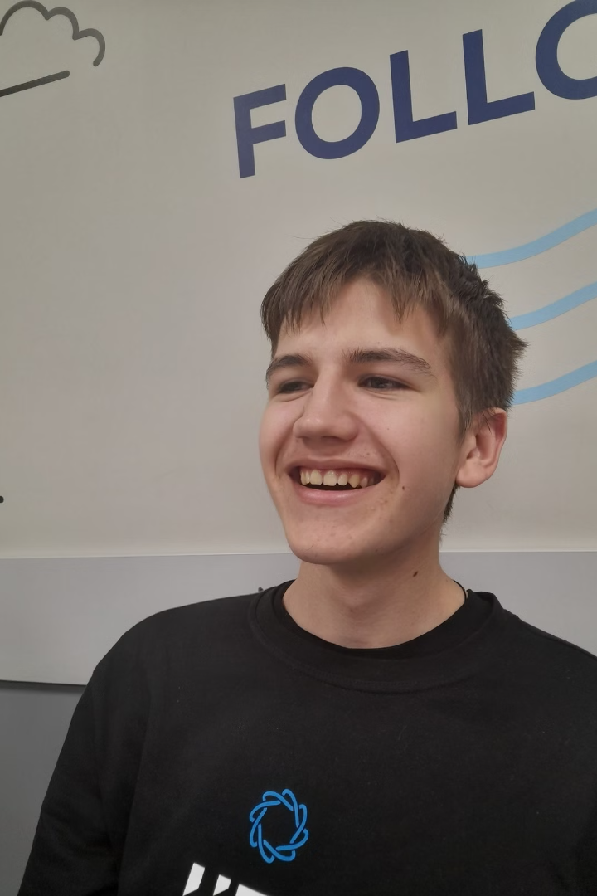
He is Vladimir Mikhnev

